Slide 1
Terraform: Provisioning Infrastructure

Slide 2
Agenda - What is Terraform? - Key Features of Terraform. - Terraform vs Others

Slide 3
What is Terraform? Terraform is a tool for building, changing, and versioning infrastructure safely and efficiently. Terraform can manage existing and popular service providers as well as custom in-house solutions. Terraform generates an execution plan describing what it will do to reach the desired state, and then executes it to build the described infrastructure. As the configuration changes, Terraform is able to determine what changed and create incremental execution plans which can be applied. The infrastructure Terraform can manage includes low-level components such as compute instances, storage, and networking, as well as high-level components such as DNS entries, SaaS features, etc.

Slide 4
Key Features : - Infrastructure as a Code - Execution Plans - Resource Graph - Change Automation

Slide 5
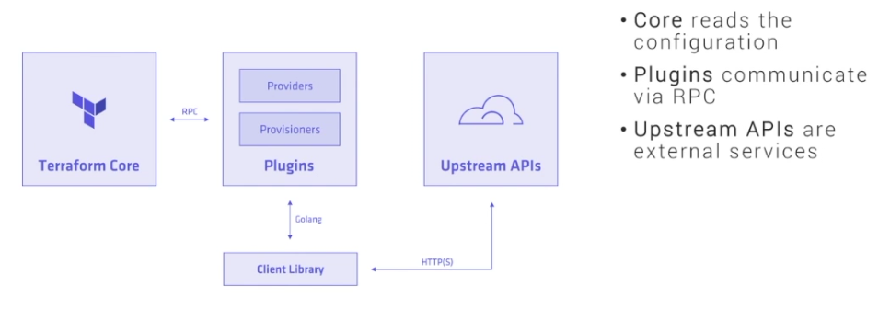
How Terraform Works :

Slide 6
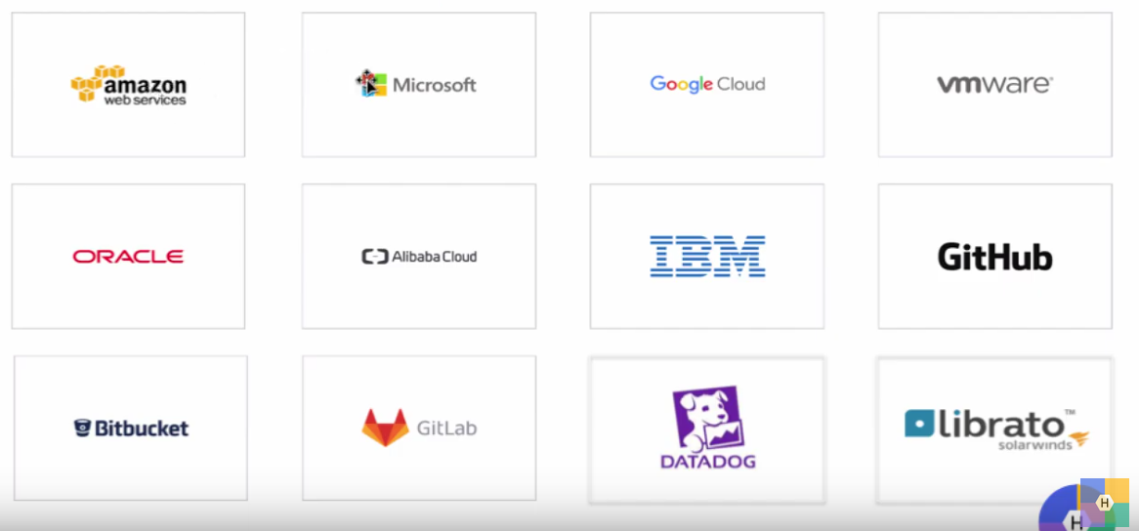
Resource Providers > 60+

Slide 7
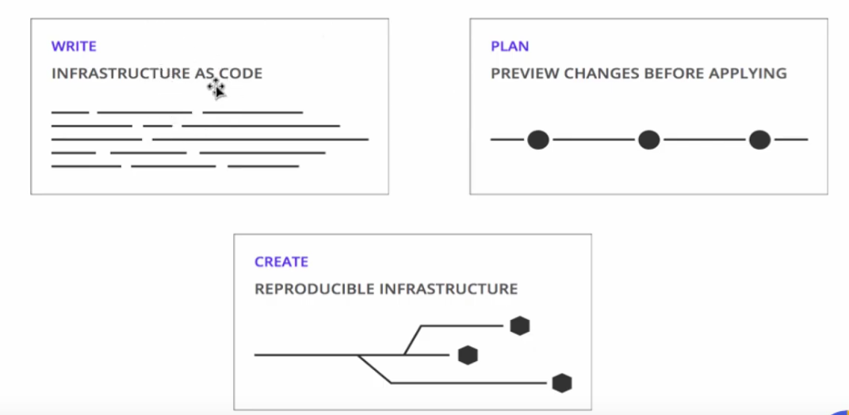
Three Simple Steps :

Slide 8
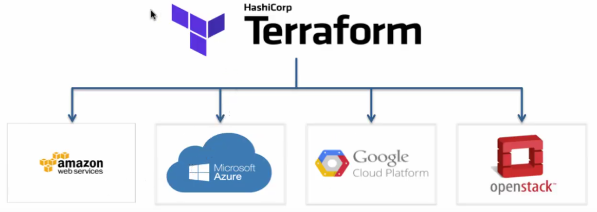
Use Terraform to manage Multi-Cloud :

Slide 9
Thanks!
Any questions?
You can find me at deepak.awslearn@gmail.com

